Slide 1
REAL-TIME LANGUAGE TRANSLATION USING AI
PIP104 University Project-II
Final-Review
Batch Number: CSE-G81
Roll Number | Student Name
20211CSE0367 | Mohammed Nihal A S
20211CSE0357 | Mahesh G
20211CSE0352 | Darshan A R
20211CSE0364 | Sandesh W D
20211CSE0389 | Rohan S Handral
Under the Supervision of,
Dr. Vijayakumar Adaickalam
Professor
School of Computer Science & Engg.
Presidency University

Slide 2
Introduction
Deep learning's capacity to replicate human learning through data processing has completely transformed technology. For tasks like picture and speech recognition, neural networks—like the Transformer model, which was unveiled in 2017—are essential. From simple ASR systems in the 1950s to programs like OpenAI's Whisper, which supports more than 99 languages and offers transcription accuracy close to human levels, ASR has advanced significantly.

Slide 3
Introduction
Whisper's inability to perform real-time transcription, however, poses problems for smooth, intuitive applications. In order to successfully overcome language barriers, this project seeks to modify Whisper for real-time transcription and translation, giving priority to accuracy, speed, and accessibility.

Slide 4
Literature Review
[1] V. R. and I. A. Funcke (2023), This study introduces aiLangu, a real-time transcription and translation system to reduce language barriers.. It serves as a foundational framework for integrating Whisper AI with tools like Google Translate to enhance multilingual communication in real-time environments.
[2] Y. Peng et al. (2023), The researchers explore training Whisper-style models using open-source data and frameworks like PyTorch and Hugging Face. Their work demonstrates Whisper AI's end-to-end architecture and multilingual strengths, making it ideal for transcription.
[3] D. Wang et al. (2019), This paper reviews the evolution of ASR systems, emphasizing transformer-based models like Transformer and Conformer for improved sequence learning. These insights align with Whisper AI's design for high-accuracy, real-time applications.
[4] D. Macháček et al. (2024), The study examines modifications needed to adapt Whisper AI for real-time transcription. Their work offers a roadmap for integrating Whisper into low-latency applications, such as speech-to-speech translation, without sacrificing transcription quality.

Slide 5
Literature Review
[5] Google Translate, Google Translate employs neural machine translation (NMT) techniques and the Transformer model to support over 100 languages. Its API capabilities enable seamless integration into transcription systems, making it a vital component for real-time speech-to-speech translation.
[6] LibreTranslate, LibreTranslate offers open-source translation with customization options and frameworks like PyTorch and OpenNMT. It supports neural machine translation while operating independently of proprietary platforms.
[7] B. Raj and R. Olivier (2022), This study evaluates Whisper AI’s resilience to adversarial noise, uncovering vulnerabilities in transcription accuracy under targeted disruptions.
[8] M. Aiken (2021), The study underscores the importance of extensive training data for reliable translations and highlights Google Translate's potential for integration with Whisper AI in multilingual voice systems.

Slide 6
Proposed Method
The proposed methodology integrates Whisper AI for real-time speech-to-text transcription, supporting multiple languages, accents, and dialects. Multilingual audio data is collected, transcribed, and translated using advanced ASR and translation models. A real-time processing pipeline combines speech recognition, neural machine translation, and text-to-speech conversion for seamless language translation with low latency.
Optimization techniques like audio chunking and parallel processing reduce delays. The system includes a user-friendly interface web interface and connects components through API integration. Extensive testing ensures accuracy and reliability across languages and scenarios, making it robust for real-world applications.

Slide 7
Objectives
Automatically detect user location to set the regional input language: The app uses geolocation to assign a regional language as the default input automatically.
Accept input via voice: Users can provide input through voice recording or text typing for flexibility.
Reduce ambient noise for clearer input: Noise-reduction techniques ensure clear voice input for accurate processing.
Utilize ASR models for transcription: Whisper AI is used to convert voice input into text with high accuracy.

Slide 8
Objectives
Utilize ASR models for transcription: Whisper AI is used to convert voice input into text with high accuracy.
Generate accurate output translations: The app translates transcribed text into the desired target language.
Save translation history for quick access: Users can revisit previous translations through a stored history feature.
Optionally implement user authentication: Authentication allows users to save and access history across devices securely.

Slide 9
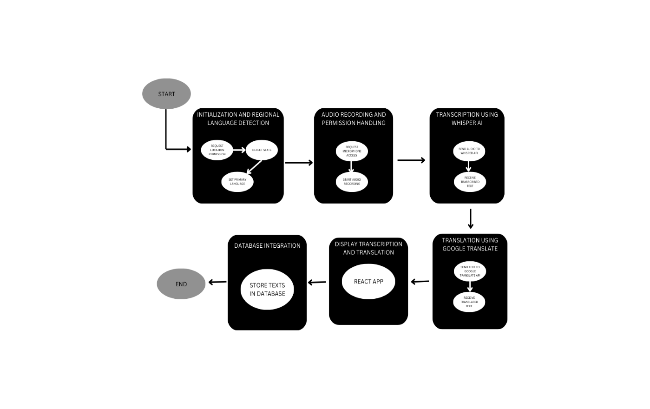
Methodology
Architecture Diagram:

Slide 10
Methodology
A real-time translation system integrates advanced speech recognition and translation models into a user-friendly app.
Architectural Design:-
Frontend: ReactJS provides a user-friendly interface for seamless interaction.
Backend: Node.js to handle transcription and translation.
Database: MongoDB stores audio files and structured data in JSON format.
Database Design: MongoDB stores user translation queries for quick accessibility.

Slide 11
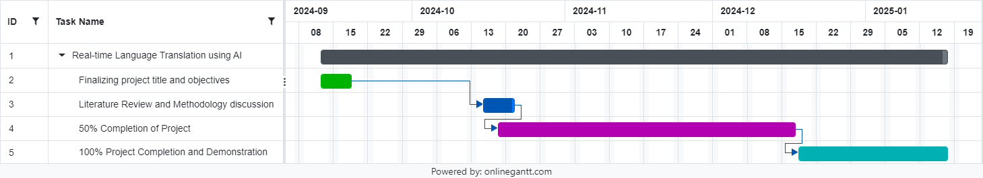
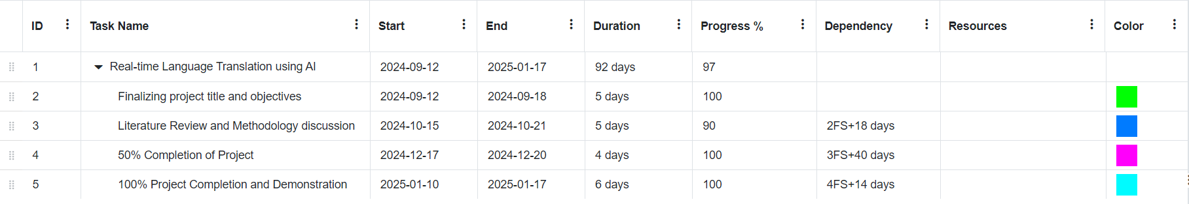
Timeline of Project

Slide 12
Conclusion
This study combines Whisper API's real-time transcription accuracy with Google Translate API's advanced multilingual translation capabilities to create an efficient language translation system. By integrating location-based language detection, it ensures precise, user-friendly translations tailored to India's diverse linguistic needs, providing a reliable solution for seamless multilingual communication.

Slide 13
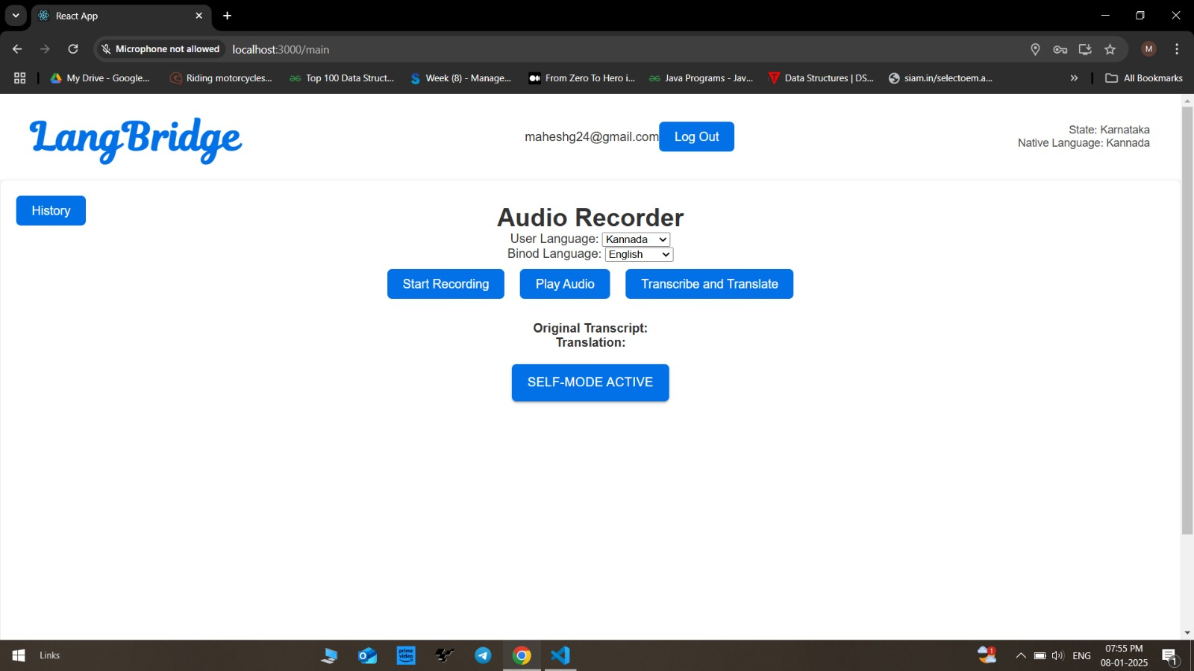
OUTPUT

Slide 14
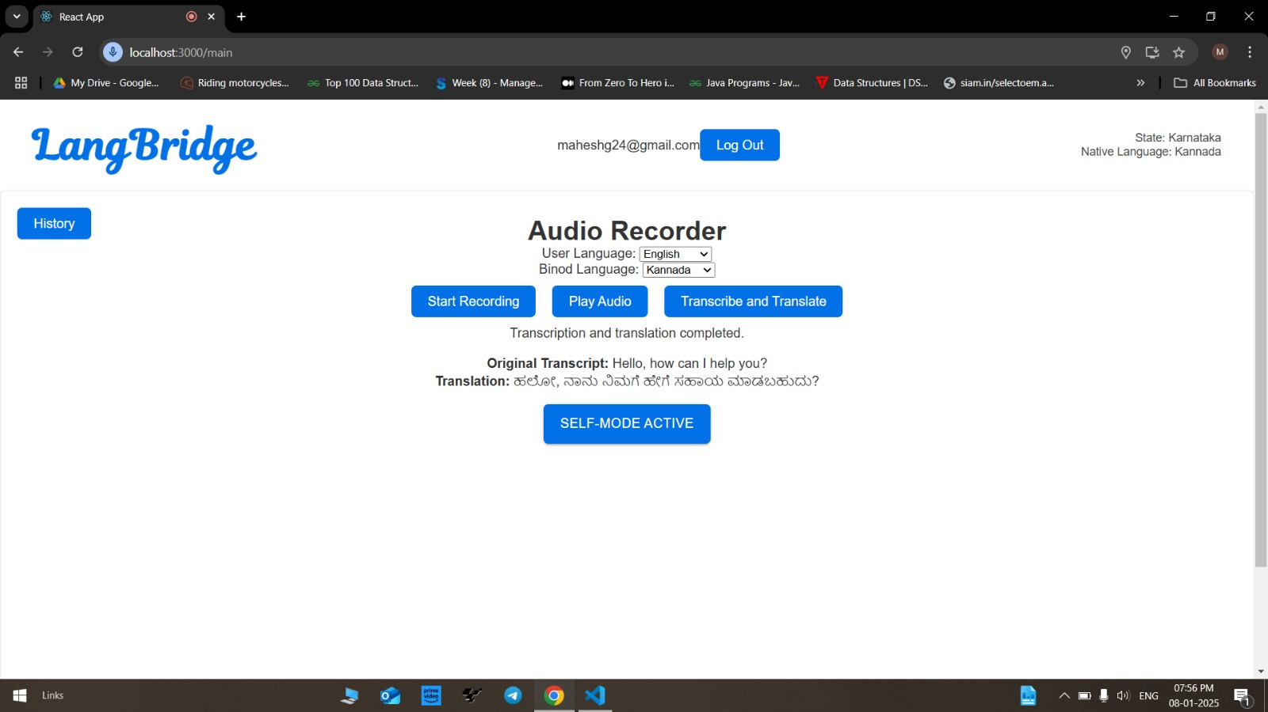
OUTPUT

Slide 15
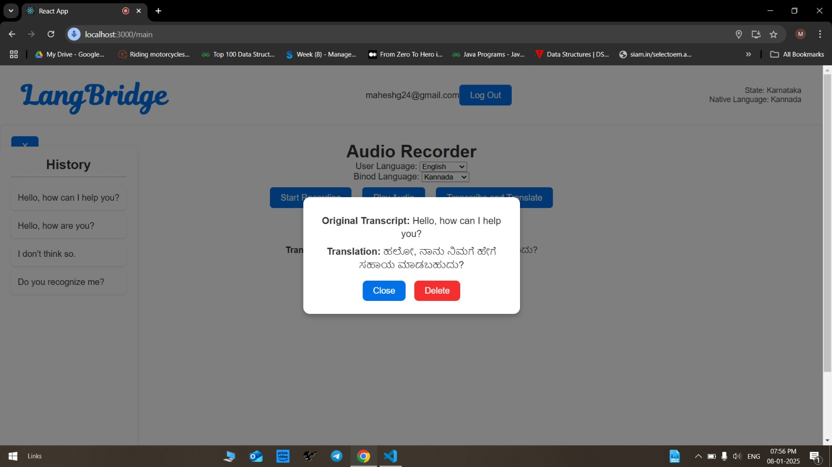
OUTPUT

Slide 16
References
[1] V. R. and I. A. Funcke, “aiLangu – Real time Transcription and Translation to Reduce Language Barriers,” KTH Royal Institute of Technology, 2023.
[2] Y. Peng et al., “Reproducing Whisper Style Training Using An Open-Source Toolkit And Publicly Available Data,” 2023, doi: 10.1109/ASRU57964.2023.10389676.
[3] D. Wang, X. Wang, and S. Lv, “An overview of end-to-end automatic speech recognition,” Symmetry. 2019, doi: 10.3390/sym11081018.
[4] D. Macháček, R. Dabre, and O. Bojar, “Turning Whisper into Real-Time Transcription System,” 2024, doi: 10.18653/v1/2023.ijcnlp-demo.3.
[5] [Online]. Available: https://play.google.com/store/apps/details?id=co m.google.android.apps.translate&hl=en&gl=US.
[6] [Online]. Available: https://github.com/LibreTranslate/LibreTranslate.
[7] R. Olivier and B. Raj, “There is more than one kind of robustness: Fooling whisper with adversarial examples,” arXiv:2210.17316, 2022.
[8] M. Aiken, “An Updated Evaluation of Google Translate Accuracy,” School of Business Administration, University of Mississippi, 2021.

Slide 17
Thank You!

